Slide 1

Simple To-Do List
Pooja Deore: 22204015
Meet Mehta: 22204004
Karan Rawat: 22204013
Project Guide
Ms. Neha Deshmukh

Slide 2
Contents
Introduction
Objectives
Scope
Features / Functionality
Project Outcomes
Technology Stack
Block Diagram if applicable

Slide 3
1. Introduction
What is To-do List?
To-Do List project is an application specially built to keep track of errands or tasks that need to be done. This application will be like a task keeper where the user would be able to enter the tasks that they need to do.
Problem Identified :
  People are finding it harder to remember and manage daily tasks in this fast-paced world.
  Solution Proposed :
1] To-Do List project is an application specially built to keep track of errands or tasks that need to be done.
2] By creating a to-do list app, users can create and manage their daily tasks more easily.

Slide 4
2. Objectives
To make sure that your tasks are written down all in one place so you don't forget anything important.
To do lists come in all shapes and sizes.
To provide the ability to plan your workflow.

Slide 5
3. Scope
To-do list has its following functions:
Organization of a proper work with an accurate planning of every task with its short description.
Simplify the workflow and a timely execution of necessary work scope.
Improvement of every employee's productivity and time management skills.

Slide 6
4. Feature /Functionality
    1] Adding numerous tasks
    2] Deleting single tasks upon Completion
    3] Deleting all tasks together
    4] Display the list of tasks
    5] Tasks/data getting stored in the Database

Slide 7
5. Outcome of Project
Increases Productivity
Helps in organizing tasks
Improves a person’s day to day life
Decreases Procrastination

Slide 8
6. Technology Stack
Python Tkinter (GUI)
MySQL (To store the user data)

Slide 9
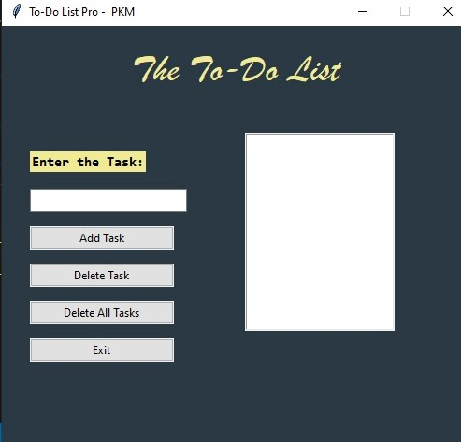
7.To Do List

Slide 10
Thank You...!!

